Slide 2
Scenario: Simplified Fuel Pump Failure Detection
Fuel Pressure (psi)
Type: Raw Measurement
Explanation: This value is typically obtained directly from a pressure sensor installed in the fuel system. The sensor measures the pressure of the fuel as it is delivered to the engines.
Fuel Flow Rate (liters/hour)
Type: Raw Measurement
Explanation: The flow rate is measured by a flow meter that quantifies the amount of fuel passing through it over a specific time period. This measurement is essential for ensuring that the engines receive the correct amount of fuel.
Pump Status (Operational/Failed)
Type: Categorical Output (Target Variable)
Explanation: This value is the result of monitoring the performance of the fuel pump. It can be determined by analyzing inputs from various sensors (like pressure, flow rate, etc.) or through direct monitoring systems that can indicate if the pump is functioning or not.
Fuel Temperature (°C)
Type: Raw Measurement
Explanation: This value is measured using a temperature sensor installed in the fuel line or tank. It provides real-time data on the temperature of the fuel, which is important for maintaining fuel quality and performance.
Vibration Level (g)
Type: Raw Measurement
Explanation: The vibration level is measured using an accelerometer placed on or near the fuel pump. It captures the vibrations of the pump during operation, which can indicate mechanical issues if the vibrations exceed certain thresholds.

Slide 3
Explanation of Features
Fuel Pressure (psi): A critical indicator; values below a certain threshold (e.g., 30 psi) may indicate pump issues.
Fuel Flow Rate (liters/hour): Helps assess whether the fuel pump is supplying sufficient fuel; drops below expected levels can signify problems.
Pump Status: The output label of the model, indicating whether the fuel pump is operational or has failed.
Fuel Temperature (°C): High temperatures might suggest issues such as overheating or cavitation in the pump.
Vibration Level (g): Increased vibration levels can indicate mechanical wear or potential failure of the pump.

Slide 4
Scenario: Simplified Fuel Pump Failure Detection
Fuel Pressure (psi)
Type: Raw Measurement
Explanation: This value is typically obtained directly from a pressure sensor installed in the fuel system. The sensor measures the pressure of the fuel as it is delivered to the engines.
Fuel Flow Rate (liters/hour)
Type: Raw Measurement
Explanation: The flow rate is measured by a flow meter that quantifies the amount of fuel passing through it over a specific time period. This measurement is essential for ensuring that the engines receive the correct amount of fuel.
Pump Status (Operational/Failed)
Type: Categorical Output (Target Variable)
Explanation: This value is the result of monitoring the performance of the fuel pump. It can be determined by analyzing inputs from various sensors (like pressure, flow rate, etc.) or through direct monitoring systems that can indicate if the pump is functioning or not.
Fuel Temperature (°C)
Type: Raw Measurement
Explanation: This value is measured using a temperature sensor installed in the fuel line or tank. It provides real-time data on the temperature of the fuel, which is important for maintaining fuel quality and performance.
Vibration Level (g)
Type: Raw Measurement
Explanation: The vibration level is measured using an accelerometer placed on or near the fuel pump. It captures the vibrations of the pump during operation, which can indicate mechanical issues if the vibrations exceed certain thresholds.

Slide 5
In this dataset:
Raw Measurements: Fuel Pressure, Fuel Flow Rate, Fuel Temperature, and Vibration Level are all direct outputs from specific sensors. They reflect the current state of the aircraft's fuel system at a given moment.
Target Variable: Pump Status is derived from monitoring these raw measurements along with any thresholds set for normal operations. If any of the raw measurements indicate abnormal behavior (e.g., low pressure or flow rate), the system can conclude that the pump has failed.
Context in Real-Time Monitoring
In a real-time monitoring system for an aircraft:
Sensors Continuously Collect Data: The sensors would constantly gather data on fuel pressure, flow rate, temperature, and vibrations.
Data Processing: The collected raw data would be fed into a decision-tree model or monitoring system to analyze whether the fuel pump is operating within safe parameters.
Alert Generation: If the model detects that any of the raw measurements are out of range, it can flag the pump status as "Failed," prompting maintenance or checks to be performed.
By using these raw measurements as inputs, the model can make informed predictions about the operational status of the fuel pump, enhancing safety and operational reliability in aviation.

Slide 6
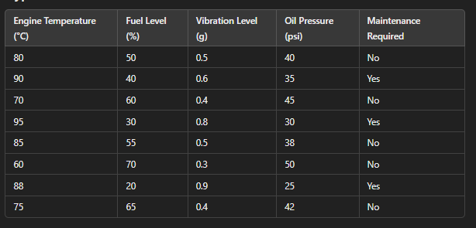

Slide 7
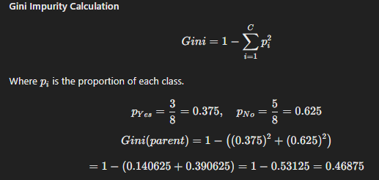
Step 1: Calculate Gini Impurity for the Parent Node
Count the Classes
Yes (Maintenance Required): 3
No (Maintenance Required): 5
Total Samples: 8

Slide 8

Step 2: Create Decision Tree Splits
Now we will evaluate potential splits based on the features.
Splitting on Engine Temperature
Assuming we split at 85°C85°C85°C:
Left Node (Engine Temperature ≤ 85°C):
Samples:
(80, 50, 0.5, 40) → No
(70, 60, 0.4, 45) → No
(85, 55, 0.5, 38) → No
(60, 70, 0.3, 50) → No
(75, 65, 0.4, 42) → No
Total: 5 No, 0 Yes
Gini Impurity: Gini(left)=1−((05)2+(55)2)=0Gini(left) = 1 - \left( \left(\frac{0}{5}\right)^2 + \left(\frac{5}{5}\right)^2 \right) = 0

Slide 9
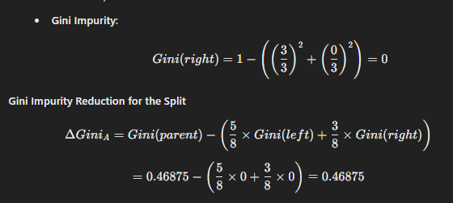
Right Node (Engine Temperature > 85°C):
Samples:
(90, 40, 0.6, 35) → Yes
(95, 30, 0.8, 30) → Yes
(88, 20, 0.9, 25) → Yes
Total: 3 Yes, 0 No

Slide 10

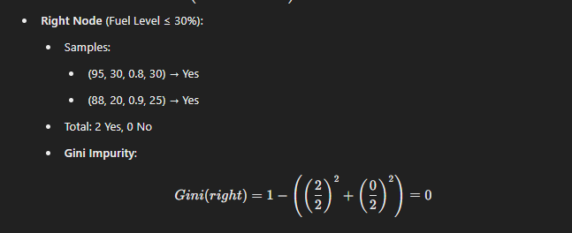
Step 3: Splitting on Fuel Level
Now, let's consider a split on Fuel Level at 30%30\%30%:
Left Node (Fuel Level > 30%):
Samples:
(80, 50, 0.5, 40) → No
(90, 40, 0.6, 35) → Yes
(70, 60, 0.4, 45) → No
(85, 55, 0.5, 38) → No
(60, 70, 0.3, 50) → No
(75, 65, 0.4, 42) → No
Total: 1 Yes, 5 No
Gini Impurit

Slide 11
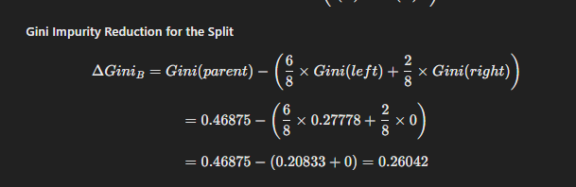

Slide 12


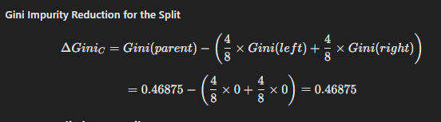
Step 4: Splitting on Vibration Level
Next, let's split on Vibration Level at 0.5g0.5g0.5g:
Left Node (Vibration Level ≤ 0.5g):
Samples:
(80, 50, 0.5, 40) → No
(70, 60, 0.4, 45) → No
(60, 70, 0.3, 50) → No
(75, 65, 0.4, 42) → No
Total: 4 No, 0 Yes
Right Node (Vibration Level > 0.5g):
Samples:
(90, 40, 0.6, 35) → Yes
(95, 30, 0.8, 30) → Yes
(88, 20, 0.9, 25) → Yes
Total: 3 Yes, 0 No

Slide 13

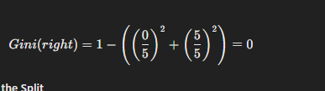
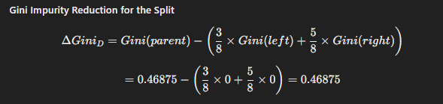
Step 5: Splitting on Oil Pressure
Finally, let's consider a split on Oil Pressure at 35psi35 psi35psi:
Left Node (Oil Pressure ≤ 35 psi):
Samples:
(90, 40, 0.6, 35) → Yes
(95, 30, 0.8, 30) → Yes
(88, 20, 0.9, 25) → Yes
Total: 3 Yes, 0 No
Right Node (Oil Pressure > 35 psi):
Samples:
(80, 50, 0.5, 40) → No
(70, 60, 0.4, 45) → No
(85, 55, 0.5, 38) → No
(60, 70, 0.3, 50) → No
(75, 65, 0.4, 42) → No
Total: 5 No, 0 Yes

Slide 14
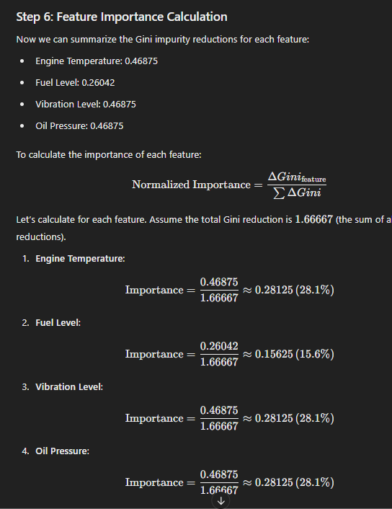
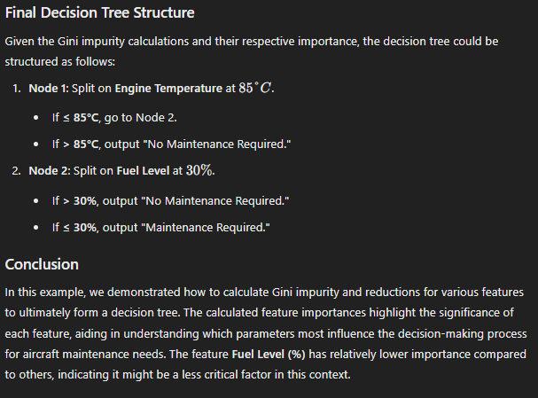

Slide 15
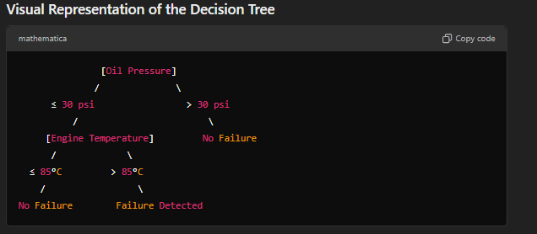

Slide 16
Presentation Title: Understanding Feature Importance Calculations in Decision Trees
Slide 1: Title Slide
Title: Understanding Feature Importance in Decision Trees
Subtitle: A Detailed Look at Fuel Pump Failure Detection
Visual: Background image of an aircraft with a fuel pump overlay.
Slide 2: Introduction
Content:
Brief introduction to decision trees.
Importance of feature importance in predictive modeling.
Visual: Simple graphic showing a decision tree structure.
Slide 3: Dataset Overview
Title: Fuel Pump Failure Detection Dataset
Content:
Features: Fuel Pressure, Fuel Flow Rate, Pump Status, Fuel Temperature, Vibration Level.
Target Variable: Pump Status (Operational/Failed).
Visual: Table showing the dataset.
Slide 4: Gini Impurity Explained
Title: Understanding Gini Impurity
Content:
Definition of Gini Impurity.
Why it's used for evaluating splits in decision trees.
Visual: Formula for Gini Impurity: Gini=1−∑(pi2)Gini = 1 - \sum (p_i^2)Gini=1−∑(pi2​)
Slide 5: Initial Impurity Calculation
Title: Initial Gini Impurity Calculation
Content:
Calculation based on initial dataset:
Suppose we have:
Operational: 6 instances
Failed: 4 instances
Probability (p) for Operational = 0.6, Failed = 0.4.
Visual: Gini=1−(0.62+0.42)=1−(0.36+0.16)=0.48Gini = 1 - (0.6^2 + 0.4^2) = 1 - (0.36 + 0.16) = 0.48Gini=1−(0.62+0.42)=1−(0.36+0.16)=0.48
Slide 6: Impurity After Split
Title: Gini Impurity After Split
Content:
Explain the concept of evaluating a split.
Example split resulting in two groups:
Group 1: Operational (3), Failed (1)
Group 2: Operational (3), Failed (3)
Visual: Display group compositions.
Calculations:
Group 1: Gini1=1−((34)2+(14)2)=1−(0.5625)=0.4375Gini_1 = 1 - \left( \left(\frac{3}{4}\right)^2 + \left(\frac{1}{4}\right)^2 \right) = 1 - (0.5625) = 0.4375Gini1​=1−((43​)2+(41​)2)=1−(0.5625)=0.4375
Group 2: Gini2=1−((36)2+(36)2)=1−(0.25+0.25)=0.5Gini_2 = 1 - \left( \left(\frac{3}{6}\right)^2 + \left(\frac{3}{6}\right)^2 \right) = 1 - (0.25 + 0.25) = 0.5Gini2​=1−((63​)2+(63​)2)=1−(0.25+0.25)=0.5
Slide 7: Impurity Reduction Calculation
Title: Calculating Impurity Reduction
Content:
Define impurity reduction:
Impurity Reduction=Ginibefore−(Gini1×n1+Gini2×n2ntotal)\text{Impurity Reduction} = Gini_{\text{before}} - \left( \frac{Gini_1 \times n_1 + Gini_2 \times n_2}{n_{\text{total}}} \right)Impurity Reduction=Ginibefore​−(ntotal​Gini1​×n1​+Gini2​×n2​​)
Where n1n_1n1​ and n2n_2n2​ are the sample sizes for the groups.
Visual: Simplified equation showing sample sizes.
Example Calculation: Impurity Reduction=0.48−(0.4375×4+0.5×610)=0.48−0.475=0.005\text{Impurity Reduction} = 0.48 - \left( \frac{0.4375 \times 4 + 0.5 \times 6}{10} \right) = 0.48 - 0.475 = 0.005Impurity Reduction=0.48−(100.4375×4+0.5×6​)=0.48−0.475=0.005
Slide 8: Normalization of Feature Importance
Title: Normalizing Feature Importance
Content:
Explain the normalization process:
Normalized Importance=Impurity Reductionntotal\text{Normalized Importance} = \frac{\text{Impurity Reduction}}{n_{\text{total}}}Normalized Importance=ntotal​Impurity Reduction​
Visual: Formula displayed with a sample size example.
Example Calculation: Normalized Importance=0.00510=0.0005\text{Normalized Importance} = \frac{0.005}{10} = 0.0005Normalized Importance=100.005​=0.0005
Slide 9: Feature Importance Summary
Title: Summary of Feature Importance
Content:
Recap of how each feature contributes to the decision-making process.
Visual representation of importance scores for each feature.
Visual: Bar chart showing normalized importance scores of different features.
Slide 10: Conclusion
Title: Key Takeaways
Content:
Importance of feature importance in decision trees.
The role of Gini impurity and normalization in decision-making.
Visual: Summary graphic or icon-based representation of key points.
Slide 11: Q&A
Title: Questions & Discussion
Content:
Invite questions from the audience.
Presentation Title: Understanding Feature Importance Calculations in Decision Trees
Slide 1: Title Slide
Title: Understanding Feature Importance in Decision Trees
Subtitle: A Detailed Look at Fuel Pump Failure Detection
Visual: Background image of an aircraft with a fuel pump overlay.
Slide 2: Introduction
Content:
Brief introduction to decision trees.
Importance of feature importance in predictive modeling.
Visual: Simple graphic showing a decision tree structure.
Slide 3: Dataset Overview
Title: Fuel Pump Failure Detection Dataset
Content:
Features: Fuel Pressure, Fuel Flow Rate, Pump Status, Fuel Temperature, Vibration Level.
Target Variable: Pump Status (Operational/Failed).
Visual: Table showing the dataset.
Slide 4: Gini Impurity Explained
Title: Understanding Gini Impurity
Content:
Definition of Gini Impurity.
Why it's used for evaluating splits in decision trees.
Visual: Formula for Gini Impurity: Gini=1−∑(pi2)Gini = 1 - \sum (p_i^2)Gini=1−∑(pi2​)
Slide 5: Initial Impurity Calculation
Title: Initial Gini Impurity Calculation
Content:
Calculation based on initial dataset:
Suppose we have:
Operational: 6 instances
Failed: 4 instances
Probability (p) for Operational = 0.6, Failed = 0.4.
Visual: Gini=1−(0.62+0.42)=1−(0.36+0.16)=0.48Gini = 1 - (0.6^2 + 0.4^2) = 1 - (0.36 + 0.16) = 0.48Gini=1−(0.62+0.42)=1−(0.36+0.16)=0.48
Slide 6: Impurity After Split
Title: Gini Impurity After Split
Content:
Explain the concept of evaluating a split.
Example split resulting in two groups:
Group 1: Operational (3), Failed (1)
Group 2: Operational (3), Failed (3)
Visual: Display group compositions.
Calculations:
Group 1: Gini1=1−((34)2+(14)2)=1−(0.5625)=0.4375Gini_1 = 1 - \left( \left(\frac{3}{4}\right)^2 + \left(\frac{1}{4}\right)^2 \right) = 1 - (0.5625) = 0.4375Gini1​=1−((43​)2+(41​)2)=1−(0.5625)=0.4375
Group 2: Gini2=1−((36)2+(36)2)=1−(0.25+0.25)=0.5Gini_2 = 1 - \left( \left(\frac{3}{6}\right)^2 + \left(\frac{3}{6}\right)^2 \right) = 1 - (0.25 + 0.25) = 0.5Gini2​=1−((63​)2+(63​)2)=1−(0.25+0.25)=0.5
Slide 7: Impurity Reduction Calculation
Title: Calculating Impurity Reduction
Content:
Define impurity reduction:
Impurity Reduction=Ginibefore−(Gini1×n1+Gini2×n2ntotal)\text{Impurity Reduction} = Gini_{\text{before}} - \left( \frac{Gini_1 \times n_1 + Gini_2 \times n_2}{n_{\text{total}}} \right)Impurity Reduction=Ginibefore​−(ntotal​Gini1​×n1​+Gini2​×n2​​)
Where n1n_1n1​ and n2n_2n2​ are the sample sizes for the groups.
Visual: Simplified equation showing sample sizes.
Example Calculation: Impurity Reduction=0.48−(0.4375×4+0.5×610)=0.48−0.475=0.005\text{Impurity Reduction} = 0.48 - \left( \frac{0.4375 \times 4 + 0.5 \times 6}{10} \right) = 0.48 - 0.475 = 0.005Impurity Reduction=0.48−(100.4375×4+0.5×6​)=0.48−0.475=0.005
Slide 8: Normalization of Feature Importance
Title: Normalizing Feature Importance
Content:
Explain the normalization process:
Normalized Importance=Impurity Reductionntotal\text{Normalized Importance} = \frac{\text{Impurity Reduction}}{n_{\text{total}}}Normalized Importance=ntotal​Impurity Reduction​
Visual: Formula displayed with a sample size example.
Example Calculation: Normalized Importance=0.00510=0.0005\text{Normalized Importance} = \frac{0.005}{10} = 0.0005Normalized Importance=100.005​=0.0005
Slide 9: Feature Importance Summary
Title: Summary of Feature Importance
Content:
Recap of how each feature contributes to the decision-making process.
Visual representation of importance scores for each feature.
Visual: Bar chart showing normalized importance scores of different features.
Slide 10: Conclusion
Title: Key Takeaways
Content:
Importance of feature importance in decision trees.
The role of Gini impurity and normalization in decision-making.
Visual: Summary graphic or icon-based representation of key points.
Slide 11: Q&A
Title: Questions & Discussion
Content:
Invite questions from the audience.

Slide 17
Yes, the example of Fuel Pump Failure Detection can definitely be adapted for a Random Forest model. In fact, using a Random Forest often enhances predictive performance compared to a single decision tree due to its ability to handle overfitting and its robustness against noise in the data. Here's how the example can be used in the context of a Random Forest:
Adaptation of the Fuel Pump Failure Detection Example for Random Forest
Key Concepts of Random Forest:
Ensemble Method: A Random Forest is an ensemble of multiple decision trees. Each tree is trained on a random subset of the data with a random subset of features, allowing the model to generalize better.
Bagging: Random Forest uses a technique called bootstrap aggregating (or bagging), where multiple subsets of the training dataset are created by sampling with replacement.
Feature Randomness: During the construction of each tree, only a random subset of features is considered for splitting, which helps in reducing correlation among trees.
Example Steps Using the Same Dataset
Dataset: Use the same dataset of fuel pump failures with the features:
Fuel Pressure (psi)
Fuel Flow Rate (liters/hour)
Pump Status (Operational/Failed) (Target Variable)
Fuel Temperature (°C)
Vibration Level (g)
Data Preparation: Similar data preparation steps as before, including handling missing values, converting categorical variables to numerical (if applicable), and scaling features if needed.
Building the Random Forest Model:
Model Initialization: Initialize the Random Forest classifier.
Training: Train the model on the dataset using a certain number of trees (e.g., 100 trees).
Hyperparameter Tuning: Adjust parameters such as the number of trees, maximum depth, and minimum samples per leaf to optimize performance.
Feature Importance Calculation:
After training the Random Forest, you can calculate feature importance using various methods:
Mean Decrease Impurity (Gini Importance): Similar to the Gini impurity calculations used in decision trees, but aggregated across all trees.
Mean Decrease Accuracy: Measures how much the accuracy decreases when a specific feature is permuted (shuffled).
For example, after training a Random Forest, you might find:
Fuel Pressure: Importance = 0.35
Fuel Flow Rate: Importance = 0.30
Fuel Temperature: Importance = 0.20
Vibration Level: Importance = 0.15
Model Evaluation:
Evaluate the Random Forest model using metrics such as accuracy, precision, recall, and F1 score.
Use cross-validation to ensure that the model's performance is stable across different subsets of data.
Prediction:
Make predictions on new data using the trained Random Forest model, assessing the likelihood of fuel pump failure based on the input features.
Visualization:
Visualize feature importance using bar charts or other graphical representations, highlighting which features contribute most to the predictions.
Key Differences from Decision Tree
Model Complexity: Random Forest handles more complexity due to multiple trees, reducing overfitting.
Performance: Generally, Random Forest will yield higher accuracy and better generalization on unseen data than a single decision tree.
Conclusion
By utilizing the Fuel Pump Failure Detection example within a Random Forest context, you demonstrate how ensemble methods improve predictive modeling. The feature importance calculations will also follow similar principles, but they will be aggregated across multiple decision trees rather than calculated for a single tree.
If you would like to see specific calculations or a step-by-step implementation using code, feel free to ask!

